Slide 1



Pseudo-classes and pseudo elements
By Rachel twede

Slide 2
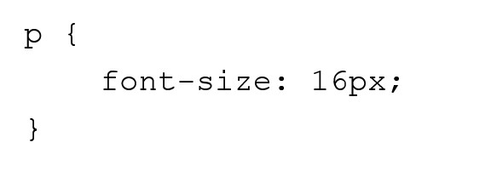
A little background: Selectors
We use selectors to tell our code what part of a document to apply a style to.
Pseudo-classes/pseudo-elements let us do this in a more nuanced way.

Slide 3
Pseudo-classes

Slide 4
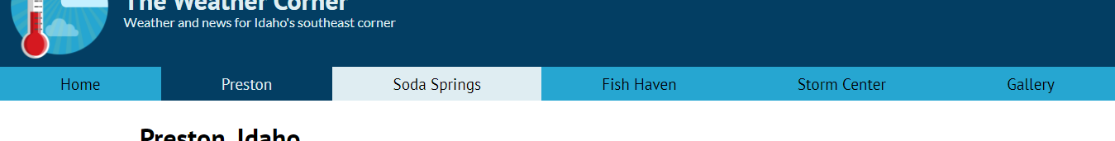

Pseudo-classes let you add styles to elements that are in a particular state.

Slide 5
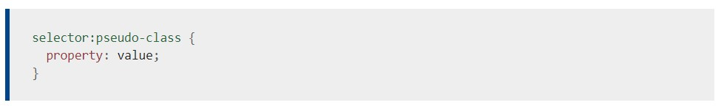
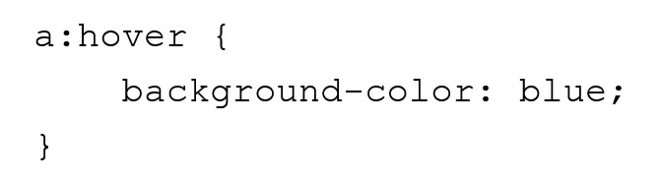

Slide 6
Types of pseudo-classes
Location pseudo-classes
User action pseudo-classes
Input pseudo-classes
Tree-structural pseudo-classes

Slide 7

…And three more
Resource state pseudo-classes
Time-dimensional pseudo-classes
Linguistic pseudo-classes

Slide 8
Pseudo-elements

Slide 9
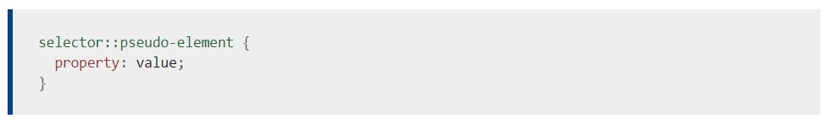
Pseudo-elements let you select a specific part of an element
Use two colons instead of one

Slide 10
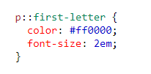

Slide 11
Examples of pseudo-elements include:
::first-letter
::first-line
::marker
::after
::before
::backdrop
::selection
To see a more complete list of pseudo-elements, visit the MDN Web Docs page here: https://developer.mozilla.org/en-US/docs/Web/CSS/Pseudo-elements

Slide 12

Fin
Resources:
https://developer.mozilla.org/en-US/docs/Web/CSS/Pseudo-classes
https://www.w3schools.com/css/css_pseudo_classes.asp
https://developer.mozilla.org/en-US/docs/Web/CSS/Pseudo-elements
https://www.w3schools.com/css/css_pseudo_elements.asp

